Slide 1
"I Wanna Be a Billionaire"
BIA500- Group 6 Capstone Project Shweta Sanjay Churi , Estella Clevenger , Jyoti Khare , Daniel Salib , Pamela Yong

Slide 2
Project Definition
Project Overview
Assist individuals & businesses to realize wealth-related objectives and financial empowerment
Uncover insights to reveal patterns among billionaires and how wealth was attained
Dataset from Kaggle
Problem Statement
Addresses the perplexing task of becoming wealthy in current economic state
Analyze societal ramifications of wealth distribution to empower people in their pursuit of financial goals
Metrics
Demographics: Age and gender distribution
Wealth vs. GDP: comparison of total wealth to GDP of Countries
Source of Wealth: Distribution of wealth by industry
Net Worth: Total net worth distribution, top 10 countries w/billionaires

Slide 3
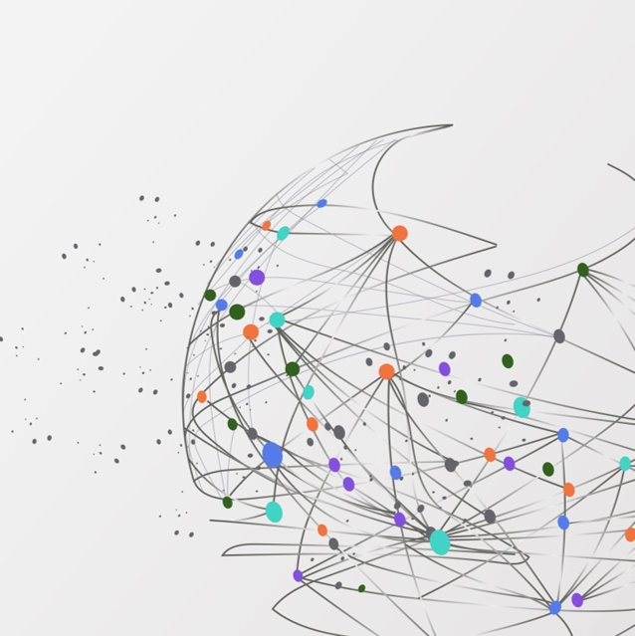
Analysis
Data Exploration
Data visualization

Slide 4
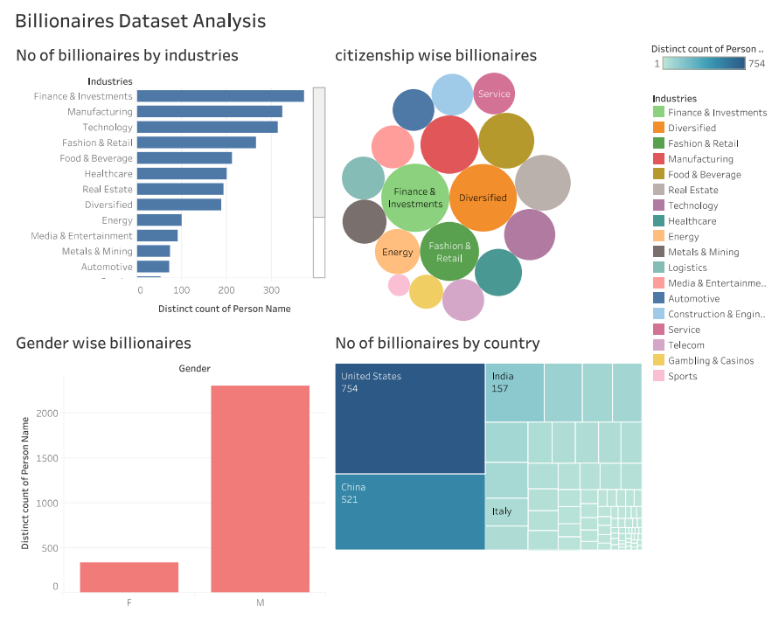

Slide 5
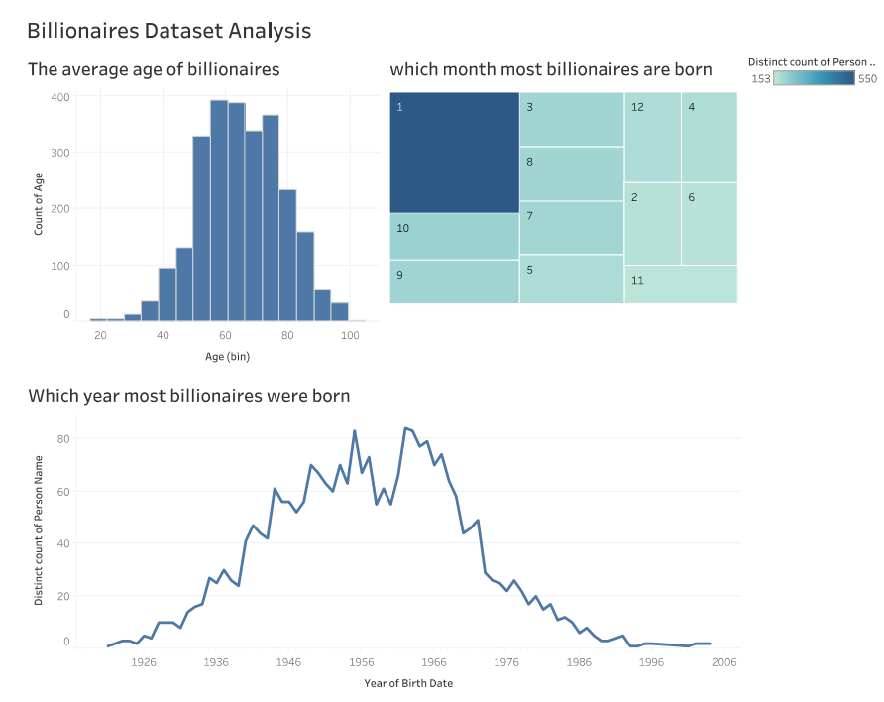

Slide 6
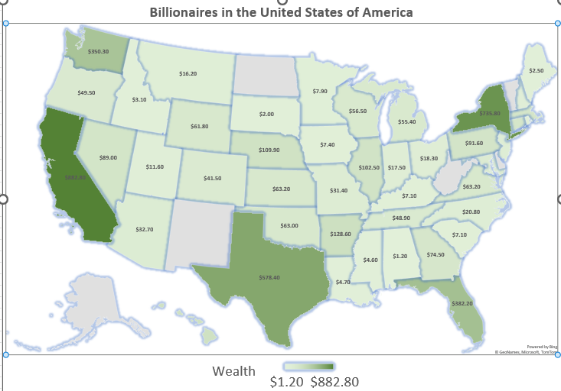

Slide 7
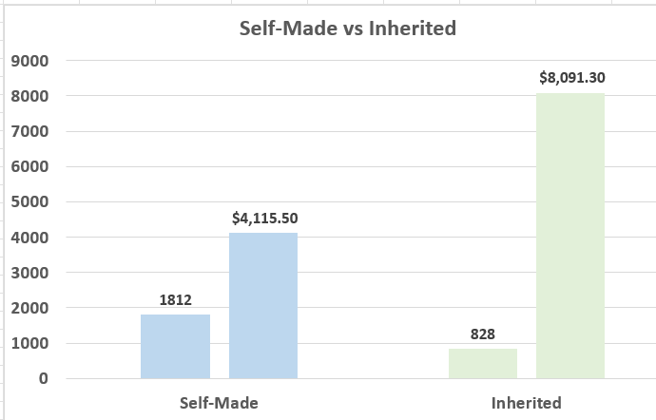
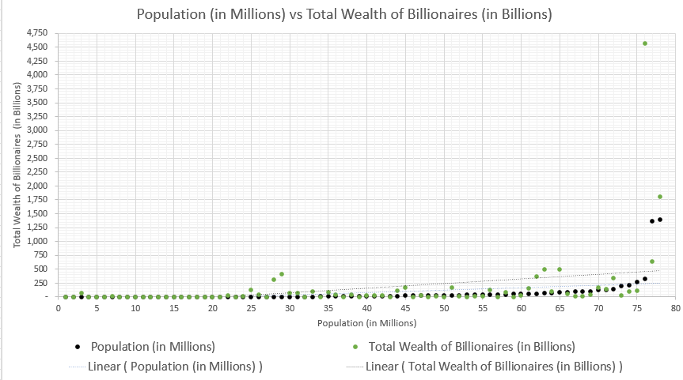
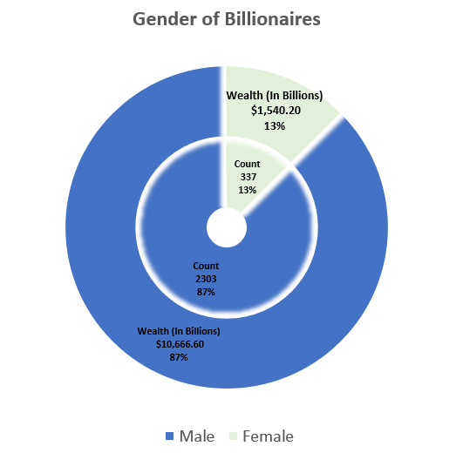
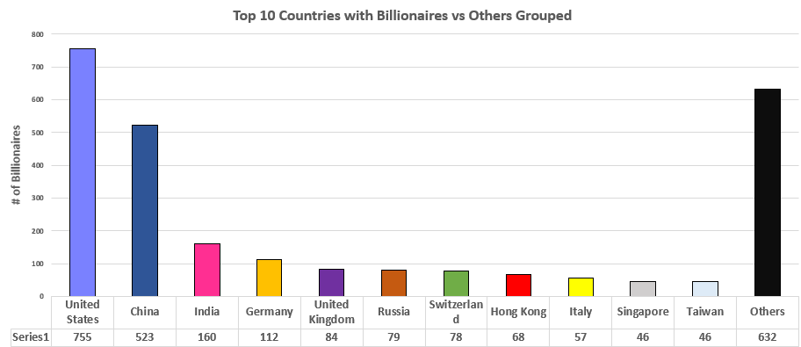

Slide 8
Methodology
Eg.
DATA PREPROCESSING
Finding missing and null values - the data set has 38 columns, out of which columns like GDP, age and industry had abnormalities - finding any outlier values for all the numeric data
IMPLEMENTATION
Exploratory Data Analysis (EDA) using histograms, pie charts on several metrics like country, industry age etc.
Performing Random Forest classier
REFINEMENT Analyzing error and identifying limitations
Eg. Increasing the tree level to 150 for better accuracy

Slide 9
Model Evaluation and Validation
1. Data Loading and Preprocessing: | 2. Model Selection – RandomForestClassifier: | 3. Model Training and Evaluation:
Loaded dataset from CSV file | Used RandomForestClassifier | Data split into training (70%) and testing (30%) sets
Imputed missing values in numeric columns using the median | settings used: 150 trees, unlimited depth, all other parameters are default | Model evaluated using accuracy and classification report (precision, recall, F1-score)
Dropped irrelevant columns (e.g., names, birth dates) | Trained to predict the binary target variable 'selfMade' | Extracted feature importance to determine significant predictors
One-hot encoded categorical variables

Slide 10
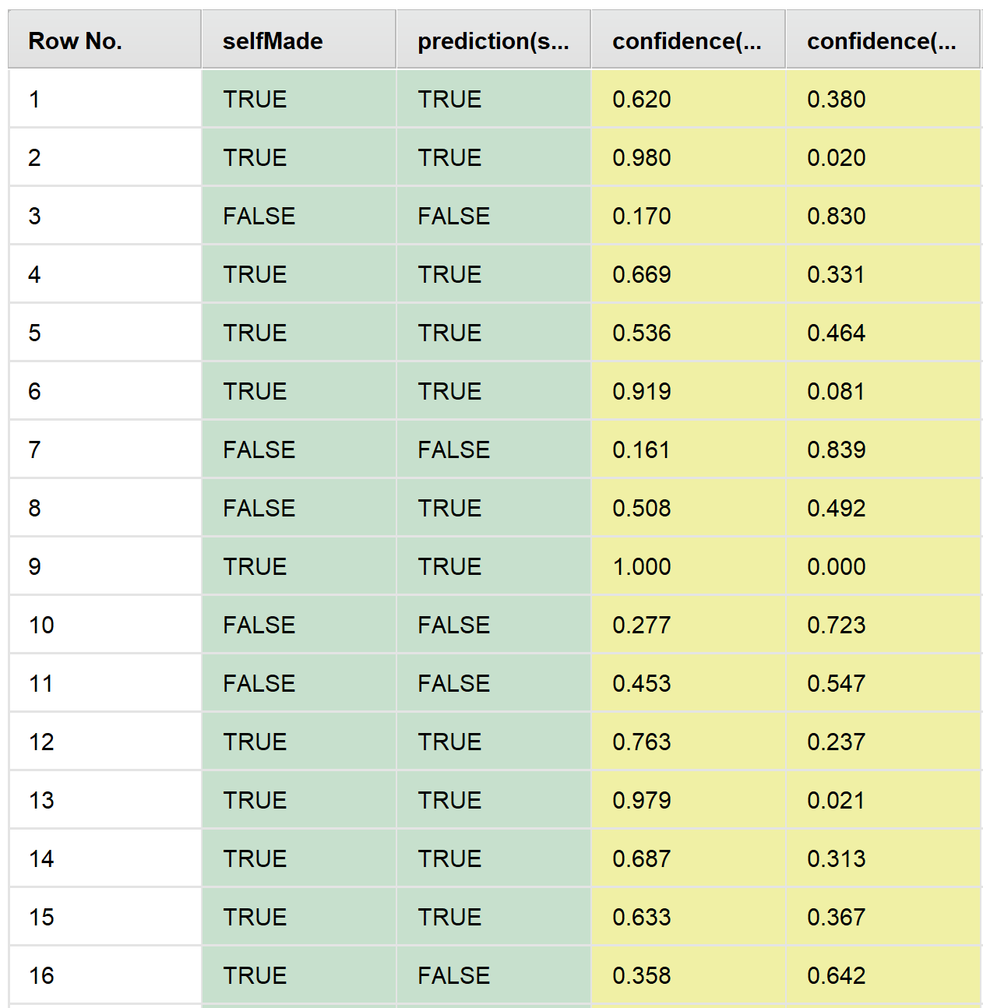
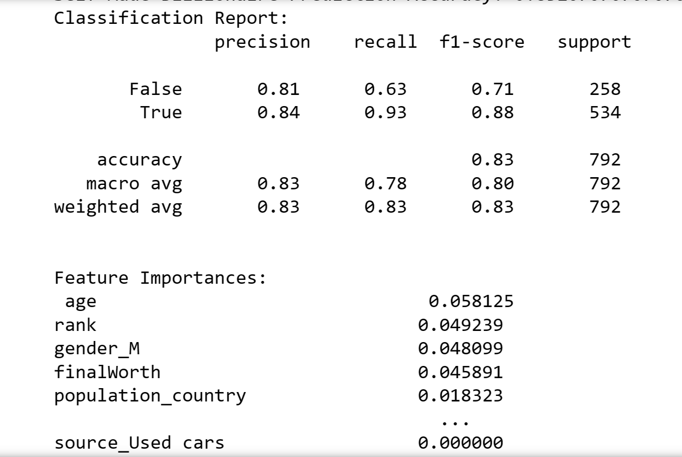
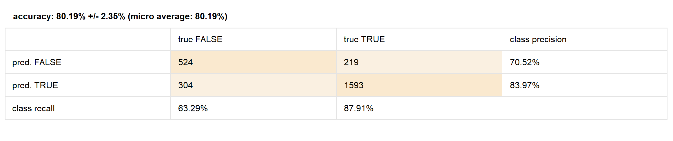
Justification

Slide 11
Reflections and Improvements
Incomplete Big Data
Purchased Data vs Open Source (Kaggle)
Size of Data Set and Defining Hypothesis
Platforms
Compatibility
User Friendly Apps
Notes:
In conclusion, we felt like we were analyzing big data with limited resources. There were many aspects that could be further delved into but we did not have the correct tools to research the topic fully. We did not have enough man-power or free resources to add in numbers for innovation, foresight, and a century of economic trends and market opportunities.
If possible, next time, we would suggest purchasing data sets from a trusted source where the sets are 100% complete instead of using Kaggle as many of the columns contained blank or unusable information. When data is not meaningful, it’s just random numbers in an Excel spreadsheet utilizing memory that could be used for other purposes.
Choose a narrower hypothesis which might allow us to use a smaller data set. When we generalize, the idea becomes unfocused, which then makes it difficult to choose what is considered relevant. Sometimes too much data is not a good thing. Also, with large data sets, we must have the right hard and software to power the research. With what us students are currently using, even the Excel worksheets were causing lagging issues.
The realization that not all platforms work well with each other, even if it’s from the same company. Charts, graphs and maps done via Excel desktop version doesn’t translate well to the 365 Online version and did not populate. Themes may or may not show up. Color schemes are off. Sizing, columns, etc., are all off when going from one program version to another with different versions like student vs professional licenses.
Mac IOS and Windows are not quite compatible with each other and hence makes sharing work difficult for different users.
Programs used to run scripts. Each user uses a different app, figure out which one is more universal and has free access as not everyone has subscriptions.
Thank you, if you have any questions, please let us know

Slide 12
Thank you!
Please feel free to ask any questions.

